Slide 1

Omaha – Lincoln
Nebraska Chapter
Sample Slides
Chapter President: Bruce Wray
Chapter VP: Ron Woerner

Slide 2

May 2025 Agenda
* Approx times All Times CDT
5:30pm
Network, Sign-in
6:00pm
Zoom Start
6:05pm
Chapter Business
6:15pm
Guest Speaker
7:15pm
Wrap-up (informal networking)

Slide 3
Chapter Business
Chapter President: Bruce Wray
Chapter VP: Ron Woerner

Slide 4
ISC2 Omaha-Lincoln Chapter Board
President: Bruce Wray
Board members:
Ron Woerner, Vice President
Patty Ellington, Secretary
Robert Copley / Roy Gertig, Treasurer
Greg Bradley, Membership
Joe Kannas, Member at Large
Volunteers Wanted!

Slide 5
ISC2 Omaha-Lincoln Chapter Marketing
Email: isc2omahalincoln@gmail.com
Website: https://isc2omaha.org/
LinkedIn: https://www.linkedin.com/groups/4266535/
Rebuilding the Chapter mailing list* * We will not sell or give away the mailing list
PLEASE HELP spread the word about the chapter!
Best

Slide 6
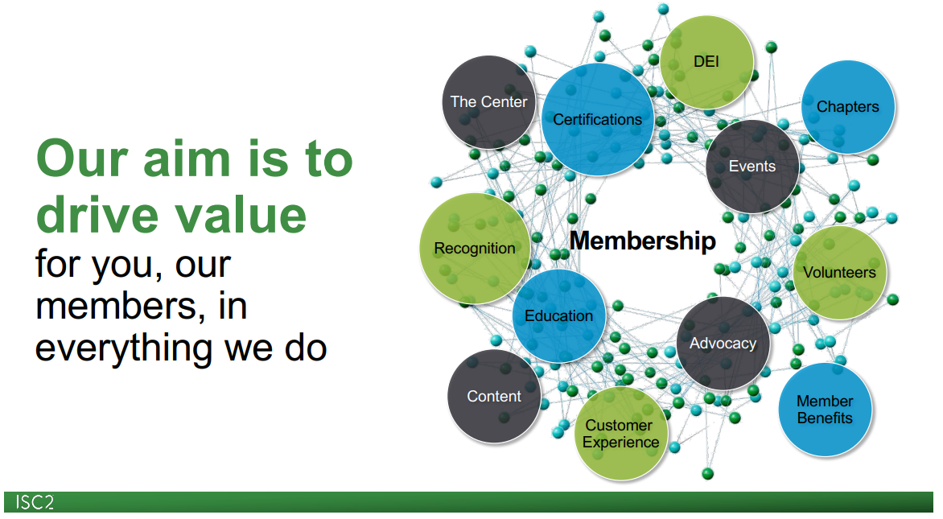
https://www.brighttalk.com/resource/core/484480/new-member-onboarding-webinar_march-2025_1030682.pdf

Slide 7
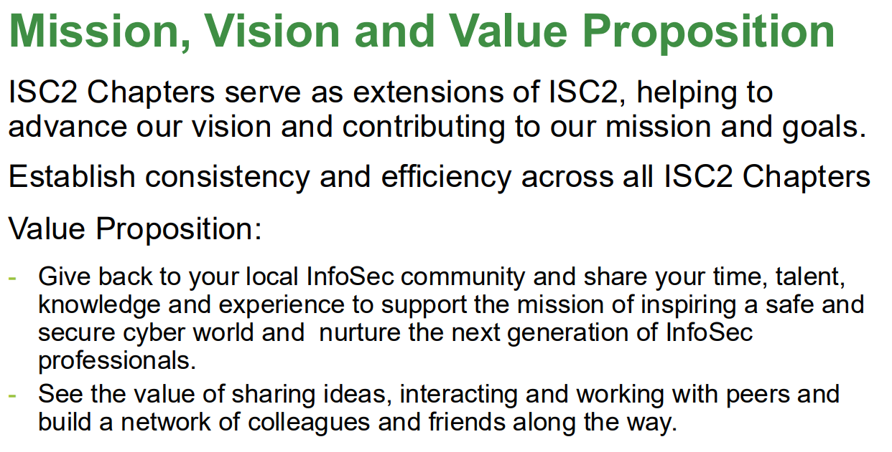

Slide 8
ISC2 Up2Date May 2025
https://www.linkedin.com/pulse/isc2-up2date-may-6th-2025-isc2-fog8e/
Topics:
Information Security and Customer Trust, Ross Stapleton-Gray, Ph.D., CISSP
CYBERUK To Focus on U.K. Cyber Resilience and Threat Landscape
Securing SATCOM Amid Rising Demands and Threats
Peace of Mind Protection Is Here to Stay
ISC2 Events:
ISC2 Chapter Leaders Summit, June 17-18, Virtual Bruce and I are facilitating, “AED for ISC2 Chapters - Shocking Life Into Your Membership”
ISC2 SECURE Washington, D.C., June 24
ISC2 Security Congress, Oct 28-30, Nashville + Virtual
ISC2 Congress-Revealed: Top 5 Trends in Cybersecurity at ISC2 Security Congress 2025

Slide 9
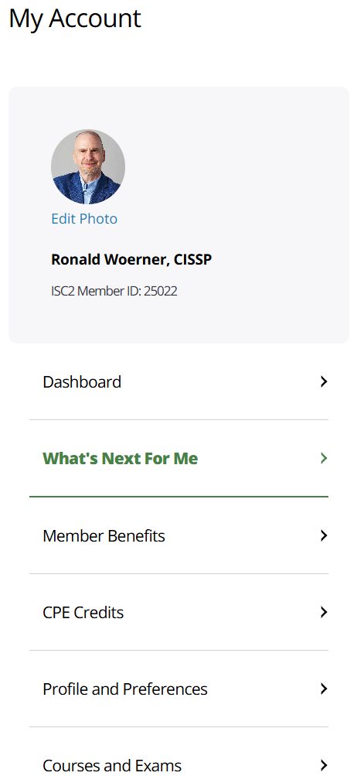
ISC2 Dashboard (NEW)
Dashboard Link (Need to have an ISC2 login)
Video introduction: https://youtu.be/lX69YG4ICz8?si=gKZIZ2ZE0Id7qLQf
What’s Next For Me
Certifications and Courses
ISC2 Insights – The latest updates, along with member views on global cybersecurity trends and issues, public policy, technology innovation and more.
Additional Resources – Connect globally, engage locally to build door-opening relationships.

Slide 10
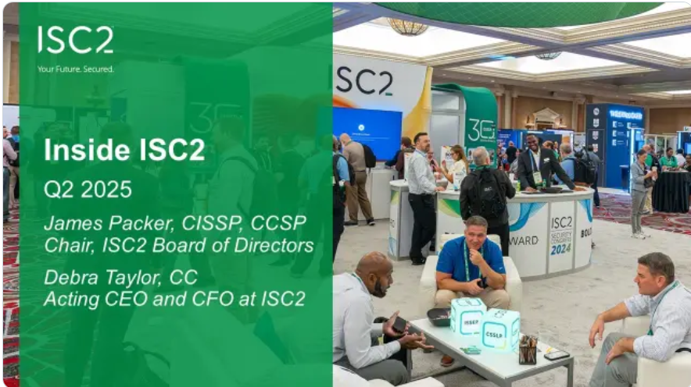
Inside ISC2: Q2 2025
https://www.isc2.org/professional-development/webinars/membership
Join us May 21, 2PM CT for the Q2 2025 Inside ISC2 webinar! ISC2 Board of Directors Chair James Packer, CISSP, CCSP, and Acting CEO and CFO Debra Taylor, CC, will share updates from the Q2 2025 Board of Directors meeting. They will discuss upcoming priorities, review recent accomplishments and answer your questions. Don’t miss it!

Slide 11
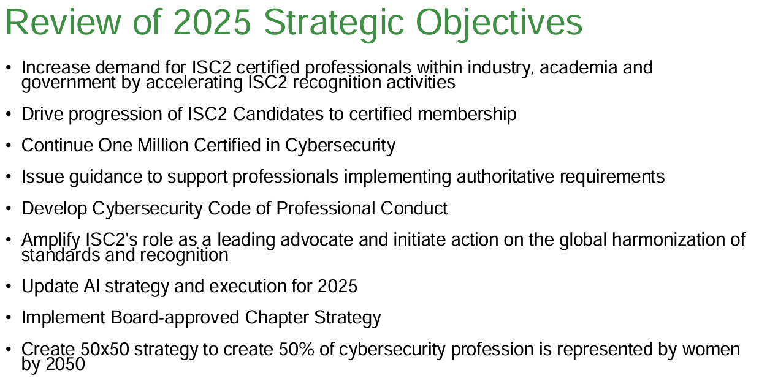

Slide 12

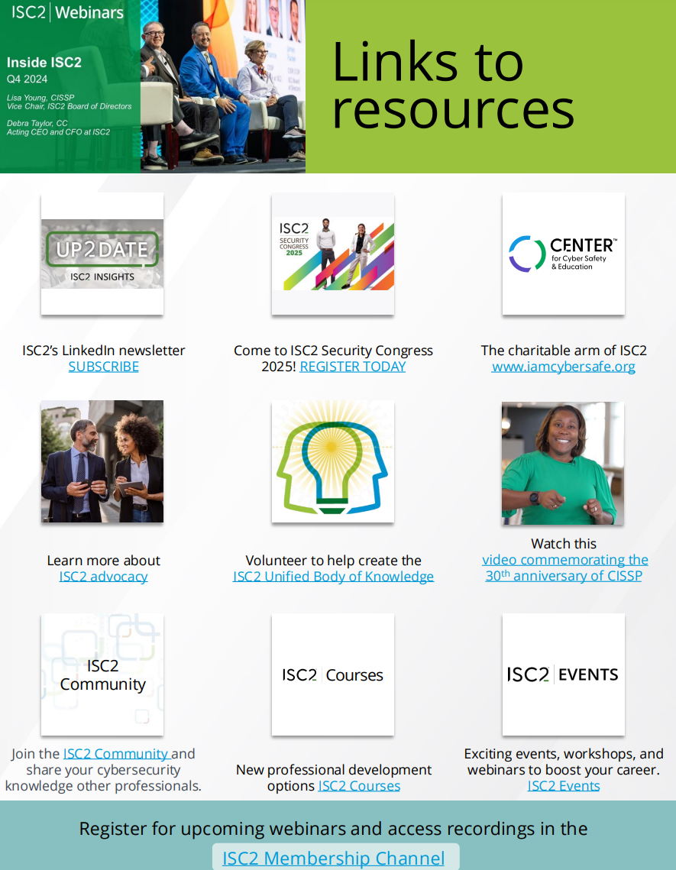
ISC2 Membership Page Link
https://www.isc2.org/professional-development/webinars/membership
https://www.brighttalk.com/resource/core/478885/121724-q4-2024-inside-isc2-links-to-resources_1018129.pdf

Slide 13
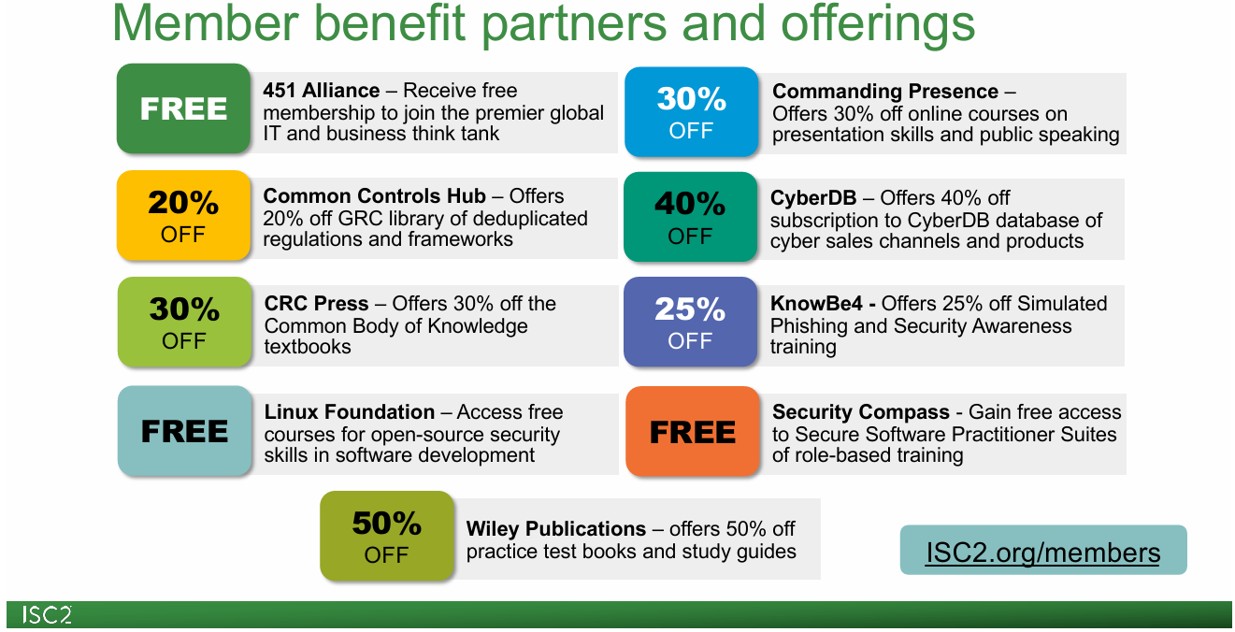

Slide 14
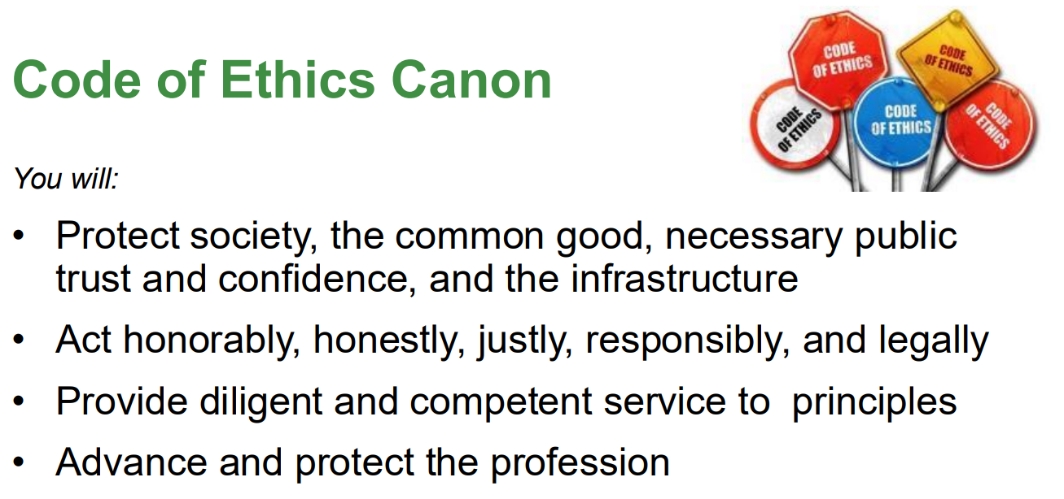
https://www.isc2.org/ethics

Slide 15
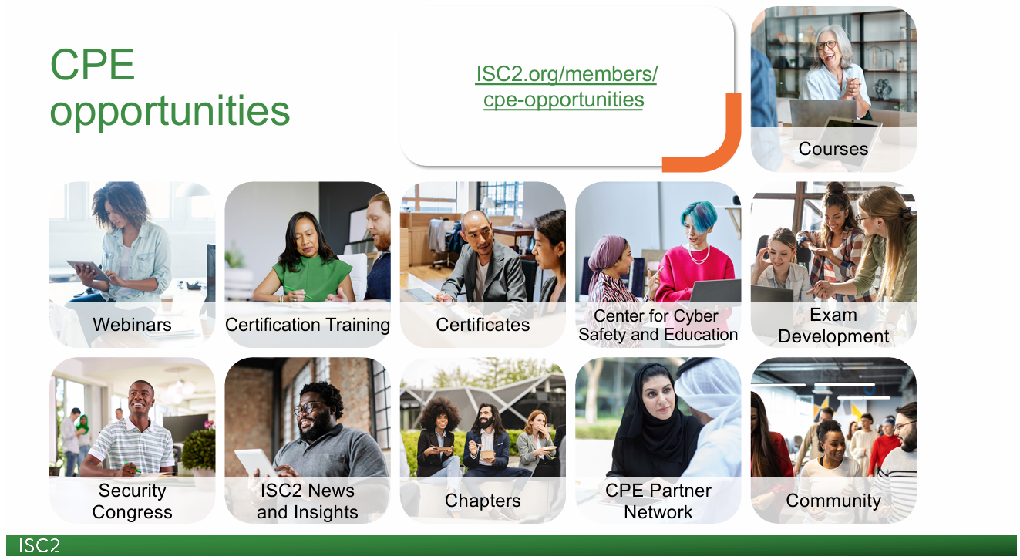

Slide 16
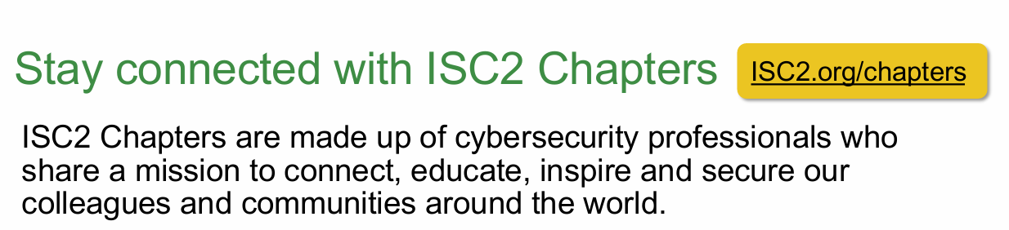
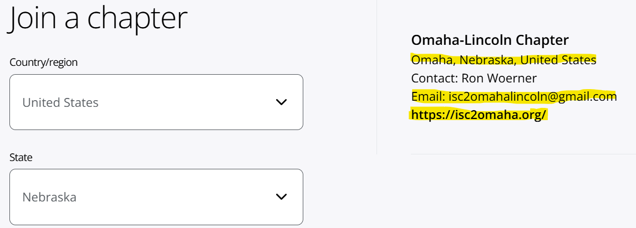

Slide 17
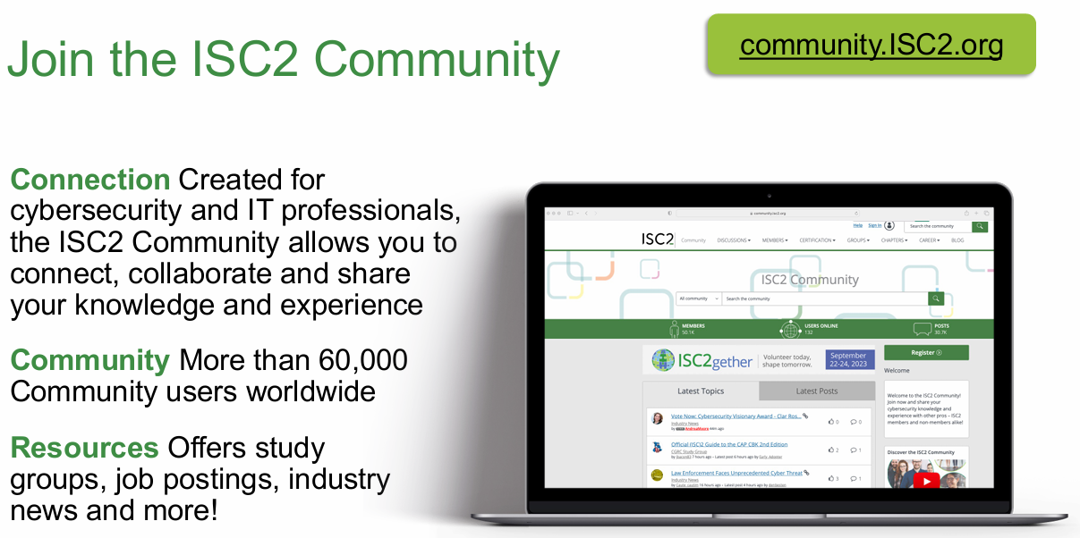

Slide 18

ISC2 Resources
CISSP General Information https://www.isc2.org/certifications/cissp
CISSP Certification Exam Outline https://www.isc2.org/Certifications/cissp/Certification-Exam-Outline
CISSP Experience Requirements https://www.isc2.org/Certifications/CISSP/experience-requirements
ISC2 CPE Credits & Activities https://www.isc2.org/Insights/2024/05/Managing-Your-ISC2-CPE-Credits-and-Activities
ISC2 Certification References https://www.isc2.org/certifications/References

Slide 19

Thank you!
Be Safe
See you next time!
Chapter President: Bruce Wray
Chapter VP: Ron Woerner

